Slide 1
Algorithmic Study of Kernel Contraction in EL
Amr Dawood, M.Sc. student
adawood@sfu.ca

Slide 2
Our Goal
Investigate contracting knowledge bases represented in Description Logic EL.
Provide a graph approach to the contraction operation.
Design heuristics for choosing the “best” set of beliefs to be removed, if there are multiple options.

Slide 3
Outline
Belief Contraction
Description Logic EL
Kernels
Contraction using Graphs
Incision functions:
Localization
Specificity

Slide 4
Belief Contraction
Birds can fly
Penguins are birds
Penguins can fly
Mumble is a penguin
Mumble can fly

Slide 5

Belief Contraction
Birds can fly
Penguins are birds
Penguins can fly
Mumble is a penguin
Mumble can fly

Slide 6

Description Logic EL
TBox
Bird $⊑$ CanFly
Penguin $⊑$ Bird
Penguin $⊑$CanFly
Penguin(Mumble)
CanFly(Mumble)
Polynomial-time subsumption algorithm: ( Tbox $⊢$ (A $⊑$ B) ) ?
A $⊑$ B : General Concept Inclusion (GCI)
ABox

Slide 7

Description Logic EL
TBox
Bird $⊑$ CanFly
Penguin $⊑$ Bird
Penguin $⊑$CanFly
Penguin(Mumble)
CanFly(Mumble)
Polynomial-time subsumption algorithm: ( Tbox $⊢$ (A $⊑$ B) ) ?
A $⊑$ B : General Concept Inclusion (GCI)
ABox

Slide 8



Kernels
TBox
Bird $⊑$ CanFly
Penguin $⊑$ Bird
Penguin $⊑$CanFly
Smallest subsets of a Tbox that imply a certain belief

Slide 9
Contraction Using Graphs
Reduce the problem to Network-Flow:
Transform the TBox into a Graph.
Define source, sink, and capacities.
Run Ford-Fulkerson algorithm, and compute maximum flow.
Compute minimum cut.
Remove the edges forming minimum cut.
Transform the Graph into TBox.

Slide 10
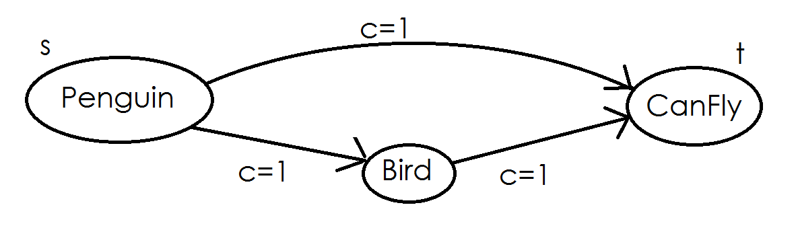
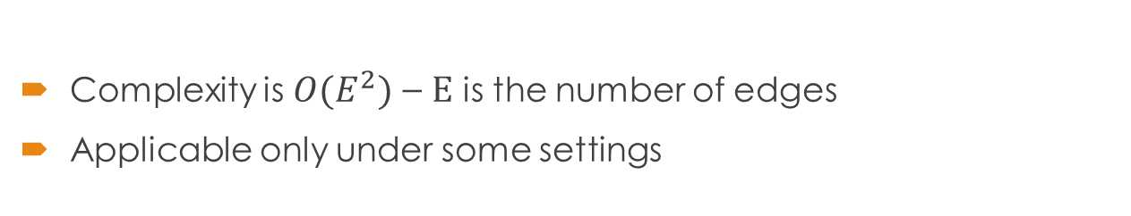
Contraction Using Graphs
Complexity is ${O(E}^{2})$ – E is the number of edges
Applicable only under some settings

Slide 11
Incision Functions
Already have a set of kernels computed – possibly using minimum hitting set algorithm?

Slide 12
Incision Functions: Localization
Intuition:
Ensure change is only applied to smallest portion of the knowledge base by affecting least number of concepts: prefer removing GCIs that share concepts or roles to ones that do not.
Method:
Compute the number of strongly-connected components in each potential GiveUpSet.
Choose the GiveUpSet with the minimum such number.

Slide 13
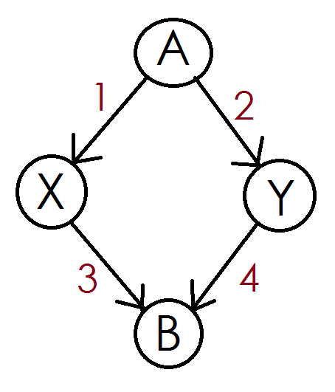
Incision Functions: Localization

Slide 14
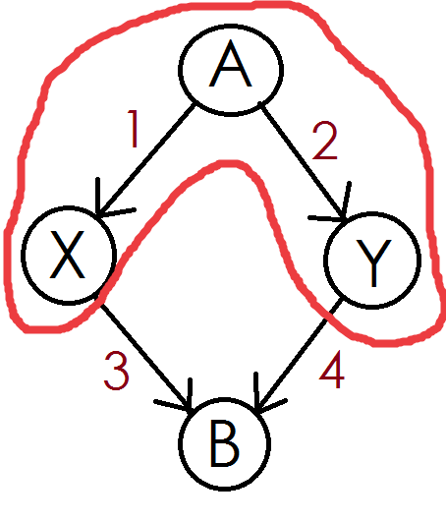
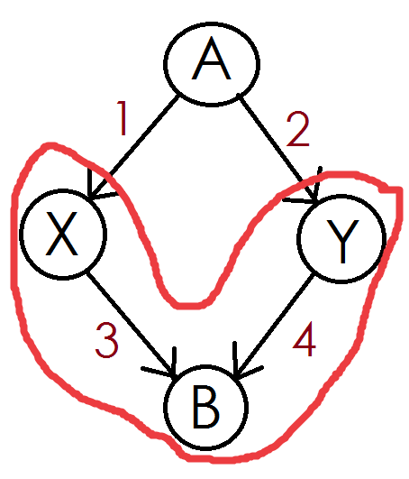

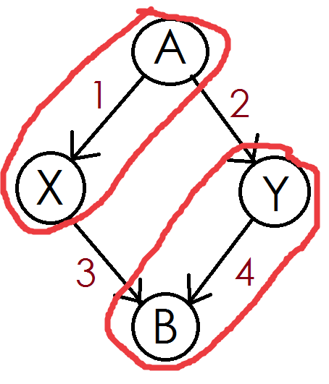
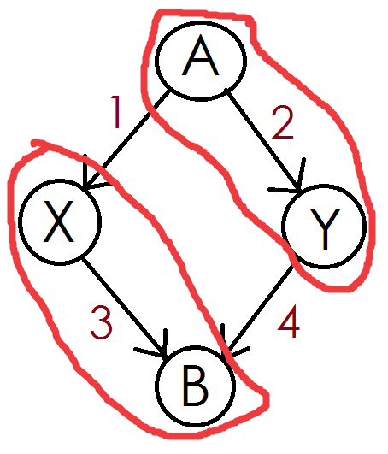

Incision Functions: Localization

Slide 15
Incision Functions: Specificity
Intuition:
Ensure the effect of contraction is minimized by removing beliefs related to most specific concepts rather than general ones.
Method:
Assign a weight to each GCI based on it’s position in the subsumption hierarchy.
Assign a weight to each potential GiveUpSet to be the sum of the GCIs’ weights.
Choose the GiveUpSet with minimum weight.

Slide 16

Incision Functions: Specificity
TBox
Vertebrate $⊑$ Animal weight=2
Mammal $⊑$ Vertebrate weight=1
Lion $⊑$ Mammal weight=0
Lion $⊑$ Animal

Slide 17
Summary
The contributions of this study are:
An graph algorithm for kernel contraction.
A revised version of Localization algorithm.
A Specificity-based incision function.

Slide 18
Questions?

